Slide 1


Topic Modeling and Sentiment Analysis of User Reviews
Latent Dirichlet Allocation (LDA) Model
Project Members
Sajal Debnath (he/his/him)
Krishanu Chattopadhayay
November’ 2024

Slide 2
Project Description
Topic Modeling and Sentiment Analysis of User Reviews
It is very important for any organization in today’s world to know the feedback and customer sentiments about their business generally in the form of reviews. This is more true for service industries like hotels, restaurants to name a few. But with the numbers being in thousands and lakhs, it is humanely impossible to read all the feedbacks and understand/co-relate the sentiments.
We are trying to solve this problem through machine learning models. Where we want to create a model which not only can go through all the reviews but divide them into topics and then find out the general sentiments on them.
So, we are aiming to do topic modeling which is used to discover hidden themes and patterns within large collections of text data, allowing researchers and analysts to understand the underlying topics discussed in a corpus of documents without manually reading each one, essentially providing a way to organize and make sense of large volumes of unstructured information by identifying recurring themes and keywords across the data.

Slide 3
Dataset Details and Data Clean Up Methods
Sajal Debnath
Krishanu Chattopadhayay

Slide 4
Dataset Details and Data Clean Up Methods
Sajal Debnath
Dataset: New York Airbnb Open Data – Kaggle
Work on subset of the data through column selection
Removal of missing values
Pre-processing:
  Replacing URLs: Links starting with "http" or "https" or "www" are replaced by "URL".
  Replacing Emojis: Replace emojis by using a pre-defined dictionary containing emojis along with their meaning. (eg: ":)" to "EMOJIsmile")
  Removing Non-Alphabets: Replacing characters except Digits and Alphabets with a space.
  Removing Consecutive letters: 3 or more consecutive letters are replaced by 2 letters. (eg: "Heyyyy" to "Heyy")
  Removing Short Words: Words with length less than 2 are removed.
  Removing Stopwords: Stopwords are the English words which does not add much meaning to a sentence. They can safely be ignored without sacrificing the meaning of the sentence. (eg: "the", "he", "have")
  Lemmatizing: Lemmatization is the process of converting a word to its base form. (e.g: “Great” to “Good”)
  Lower Casing: Each text is converted to lowercase.
Tokenization of words

Slide 5
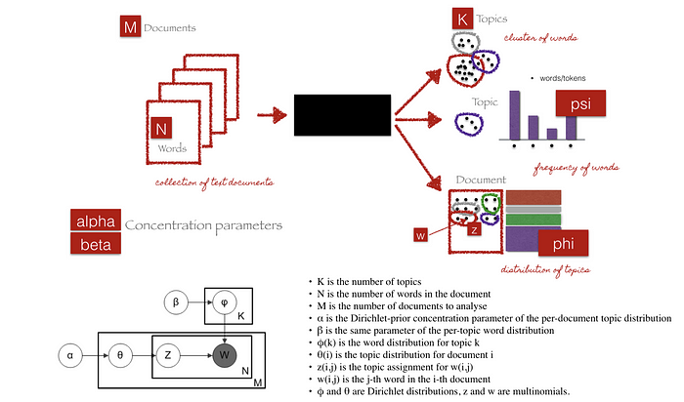
ML Methods and Details
Latest Dirichlet Allocation (LDA Model) and Sentiment Analysis Through VADER
Term Frequency-Inverse Document Frequency (TF-IDF): A technique in natural language processing where the TF-IDF weighting scheme is used to identify important words within a corpus of documents, allowing for the extraction of key themes and topics across the collection
Latent Dirichlet Allocation (LDA): Considered the gold standard, it uses a probabilistic framework based on Dirichlet distributions to model how topics are distributed within documents and words within topics.
Latent Semantic Analysis (LSA): A foundational technique that uses singular value decomposition (SVD) to identify latent semantic relationships between words in a corpus.
Non-negative Matrix Factorization (NMF): A matrix factorization method that ensures all components (topics and words) are non-negative, often preferred for interpretability.
Probabilistic Latent Semantic Analysis (pLSA): Similar to LSA but with a probabilistic model, offering better theoretical grounding.
*** Please check Sajal Debnath’s GitHub Repository for all the details.
Picture Source: https://towardsdatascience.com/end-to-end-topic-modeling-in-python-latent-dirichlet-allocation-lda-35ce4ed6b3e0

Slide 6

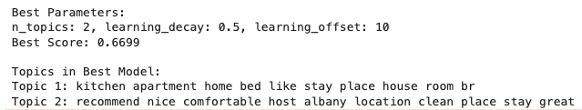
Results – Sajal Debnath
Sajal Debnath
Krishanu Chattopadhayay
I am using Coherence score using cosine similarity to calculate the result.
The coherence score before hyper tuning is 0.2495
After hyper tuning the best score is 0.6699

Slide 7
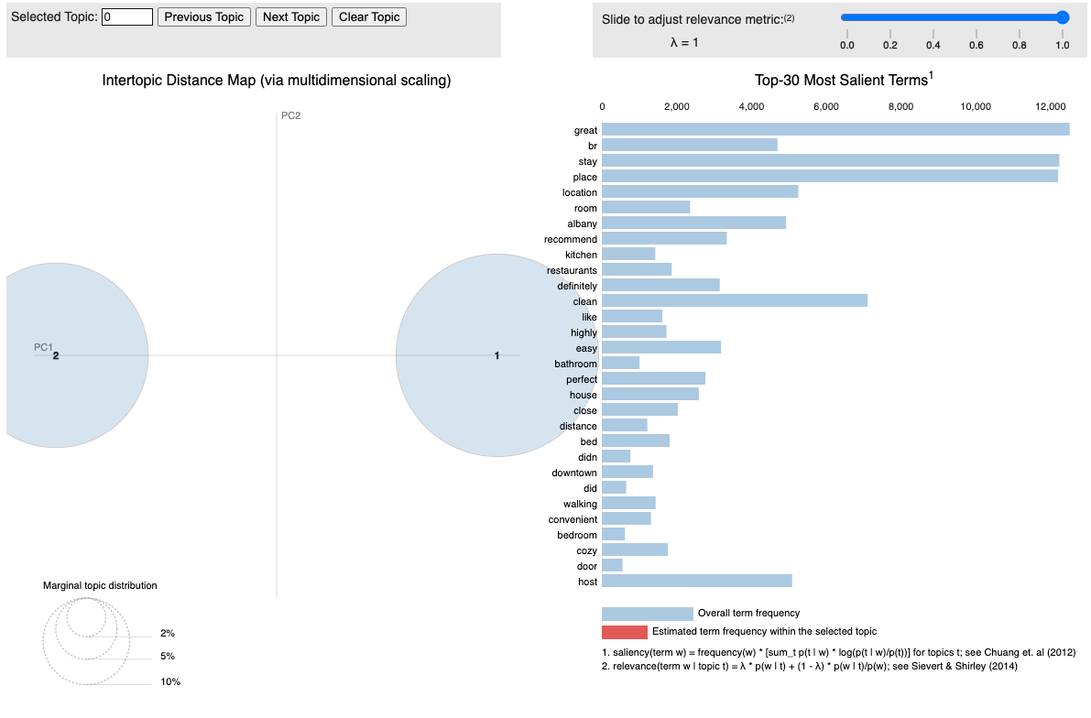
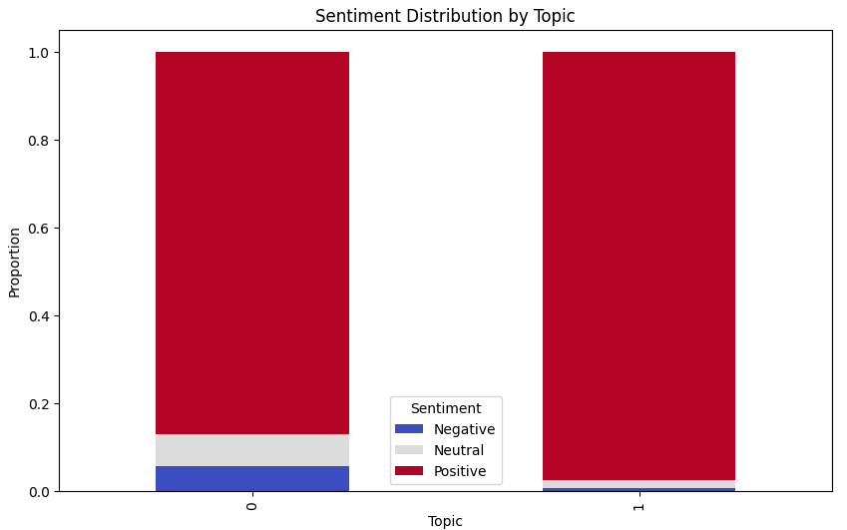
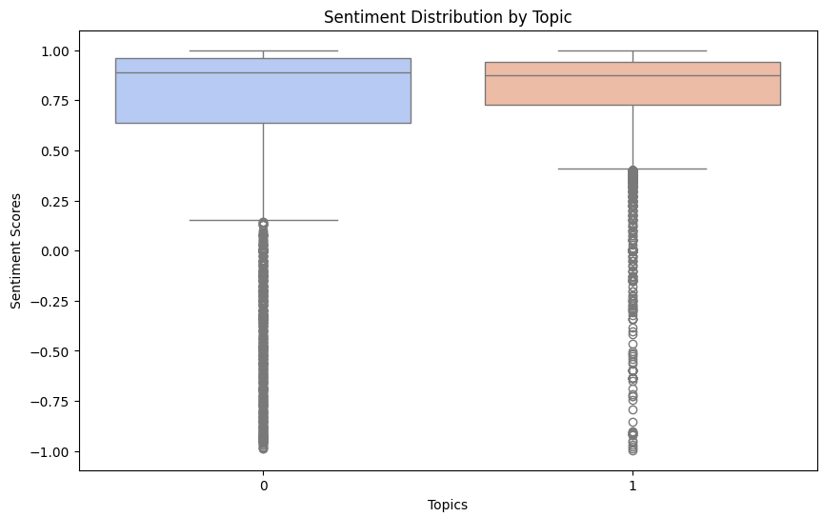
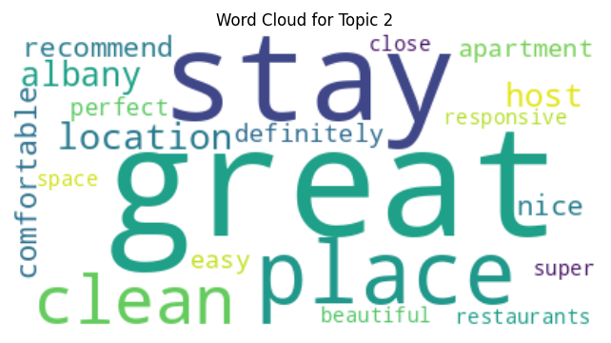
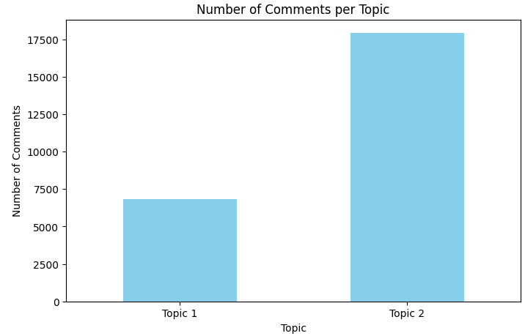
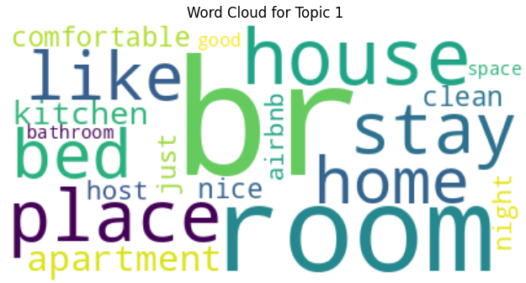
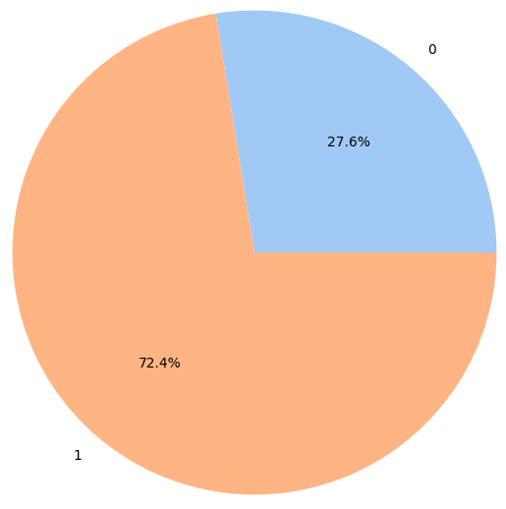
Results Screenshots

Slide 8
Contributions
Sajal Debnath
Krishanu Chattopadhayay
Data cleanup and acquisition - 50 / 100
ML Model Selection/ Training - 50/ 100
Hyper parameter tuning - 50 /100
Metrics - 50/ 100
Presentation - 50 / 100
Documentation - 50 / 100
Data cleanup and acquisition - 50 / 100
ML Model Selection/ Training - 50 / 100
Hyper parameter tuning - 50 /100
Metrics - 50 / 100
Presentation - 50/ 100
Documentation - 50 / 100

Slide 9
Conclusion
In conclusion we can say that while LDA is a very powerful tool, there are other models we need to explore. For example, pLSA model and others. Also, we need to continue working on the datasets and the model to make it more useful.
We need both time and effort to fine tune the models and adopt it as per the datasets.
For the Airbnb dataset, the sentiment is overwhelmingly positive, this is due to the nature of the reviews. We need to test the model with other datasets with actual rating and compare them with the generated ratings to find out the accuracy of the model.

Slide 10
https://sajaldebnath.com

